Slide 1

Key Legal and Regulatory Issues Affecting Community Broadband Projects
Broadband Communities Summit
April 6, 2016
Austin, TX
Sean Stokes Casey Lide
www.baller.com

Slide 2
DISCLAIMER
This presentation does not constitute legal advice and should not be interpreted as such.
For advice on federal, state or local law, please consult qualified legal counsel.

Slide 3
OVERVIEW
  Our focus today: Legal and regulatory issues affecting service providers, as such.
  Authority Issues
  Open Internet Order / Title II Reclassification of BIAS
  Poles & Infrastructure
  Federal Universal Service Program
  Cable Service, OTT Video and Local Franchising

Slide 4
Community Broadband Authority Issues
Authority
Federal law encourages, but does not authorize
Public entities (including coops) must have state/local authority
  State laws, interpretations, procedures differ widely
  Dillion’s Rule v. Home Rule
  Service-by-service (cuts both ways)
  For example, in City of Bristol, VA v. Earley, 145 F.Supp.2d 741, 745 (W.D. Va. 2001), the court held that the City has authority to provide telecommunications services, and in Marcus Cable Associates, L.L.C. v. City of Bristol, 237 F.Supp.2d 675, 678-79 (W.D.VA 2002), the same court held that the City does not have authority to provide cable television service. According to the court, the critical difference was that Virginia’s statute authorizing localities to establish “public utilities” applied to telecommunications services but not to cable television.

Slide 5
Barriers To Public Entry
State “barriers” (not necessarily “prohibitions”): AL, AR, CA, CO, FL, LA, MI, MN, MO, NC, NE, NV, PA, SC, TN, TX, UT, VA, WA, WI (http://goo.gl/H3JVfw)
Some barriers to broadband others to telecom, or cable
Broad based public-private sector support has helped recast the debate away from public v private
From 2005-2010 most efforts at barriers defeated, 2011-2015 laws in NC and SC enacted but defeated in GA, IN, KS, MO and UT
2016 negative bill killed in CO and pending in MO

Slide 6
State Barriers Section 253 – Nixon Case
Section 253
“No State or local statute or regulation, or other State or local legal requirement, may prohibit or have the effect of prohibiting the ability of any entity to provide any interstate or intrastate telecommunications service.” Telecom Act § 253(a) (47 U.S.C. § 253(a))
Nixon v. Missouri Municipal League, 541 U.S. 125 (2004):
Nixon held that “any entity” language in § 253(a) not clear enough to meet Ashcroft “plain statement” standard (Gregory v. Ashcroft , 501 U.S. 542 (1991)) to preempt state laws involving “traditional” or “fundamental” state functions.

Slide 7
State Barriers to Entry Section 706
Section 706
(a) In general. The Commission…shall encourage the deployment on a reasonable and timely basis of advanced telecommunications capability to all Americans … by utilizing … other regulating methods that remove barriers to infrastructure investment.
(b) Inquiry. The Commission shall … determine whether advanced telecommunications capability is being deployed to all Americans in a reasonable and timely fashion. If the Commission’s determination is negative, it shall take immediate action to accelerate deployment of such capability by removing barriers to infrastructure investment and by promoting competition in the telecommunications market.
  -- 47 U.S.C. §1302

Slide 8
FCC Section 706 Preemption Order
February 26, 2015 – FCC adopts Order granting Section 706 petitions for preemption filed by the Electric Power Board of Chattanooga, TN and Wilson, NC (WC Dockets No. 14-115 and 14-116) (http://goo.gl/uaeEAp)
Finds that the TN and NC laws are acting as barriers to broadband infrastructure development
  Significant federal presence regulating Internet
  Commercial barriers not subject to Nixon v. Missouri Municipal League “clear statement” standard.
  Does not grant authority
  Does not preempt prohibition
  Order only applies in NC and TN
NC and TN both appealed FCC Order in U.S. Court of Appeals for 6th Circuit. Oral argument held on March 17

Slide 9
Self-Imposed Barriers
Charters
Local ordinances
Non-compete provisions in franchises, pole attachment or lease agreements
Most favored nations agreements
Barriers may be substantive or process

Slide 10
Public Private Partnership: Authority Issues
State law
About 30 States have P3 laws
Some are broad (Maryland) and some are narrow (Florida)
Only a few address broadband specifically
Limitations on use of tax favored financing for private use

Slide 11
II. FCC Open Internet Order
Background:
  2010 Open Internet Rules
  Section 706
  Verizon v. FCC:
    Upheld FCC’s authority under Section 706 but “[g]iven the Commission’s still-binding decision to classify broadband providers . . . as providers of ‘information services,’ open Internet protections that regulated broadband providers as common carriers would violate the Act.”
  FCC Order on Remand, March 12, 2015

Slide 12
Open Internet Rules
Key “Open Internet” Rules:
  No Blocking (subj. to “reasonable network management”)
  No Throttling (subj. to “reasonable network management”)
  No Paid Prioritization
  Transparency (Enhanced)
    Fewer than 100k subscriber = temp. exemption from enhancements; must still comply with 2010 rules
    2010 rules: publicly disclose network mgt. practices, performance and commercial terms
    Enhanced: promo rates, data caps, packet loss
  Equal application to fixed and mobile
  Interconnection issues on a case-by-case basis

Slide 13
Open Internet Order:
Title II Reclassification of BIAS
The Communications Act of 1934, as amended, consists of seven major sections or “titles”:
  Title I – General Provisions
  Title II – Common Carriers
  Title III – Provisions related to radio
  Title IV – Procedural and administrative provisions
  Title V – Penal provisions, forfeitures
  Title VI – Cable communications (added by CCPA of 1984)
  Title VII – Miscellaneous provisions

Slide 14
Open Internet Order:
Title II Reclassification of BIAS
Why:
  Jurisdiction for implementation of Open Internet rules (along with Section 706)
  Desire for regulatory symmetry, simplicity
What:
  Radical change in regulatory treatment of “broadband Internet access service” (BIAS), previously an unregulated “information service”
  BIAS = “telecommunications service” (“telecommunications,” offered on a common carrier basis)
“Light touch Title II regime” applies

Slide 15
Title II Reclassification
“Broadband Internet Access Service”:
  “a mass-market retail service by wire or radio that provides the capability to transmit data to and receive data from all or substantially all Internet endpoints”
“Mass market”:
  “[S]ervices marketed and sold on a standardized basis to residential customers, small businesses and other end-user customers such as schools and libraries.”
  Specifically includes BIAS purchased via E-Rate/RHP, or using network supported by CAF.
Does not include “enterprise service offerings or special access services, which are typically offered to larger organizations through customized or individually negotiated arrangements.”

Slide 16
Title II Reclassification: Application and Forbearance
Some aspects of Title II apply to BIAS, some don’t.
FCC forbears from 27 provisions of Title II of the Communications Act, and over 700 Commission rules and regulations
Open Internet Order states the following “core requirements” do apply:
  Open Internet rules
  Infrastructure Access Rights and Obligations (Section 224)
  “Core Title II Obligations”
  Customer Privacy (Section 222) – Rules apply, but forbearance until more specifically addressed in separate rulemaking
  Access for Persons With Disabilities
  Universal service (Section 254) – Applies, but forbearance from contribution requirements, for now

Slide 17
Title II Reclassification: Application
New Development: Customer Privacy – Section 222
  Open Internet Order: General CPNI obligations apply, but forbearance from application to BIAS until details are addressed in separate rulemaking
  March 31, 2016 NPRM:
    BIAS providers may share user info for marketing and other purposes “consistent with customer expectations.” No opt-in requirement.
    All other uses would require opt-in consent

Slide 18
Title II Reclassification: Other Issues
States:
  BIAS is “interstate” in nature
  Internet Tax Freedom Act prohibits states and localities from imposing “taxes on Internet access,” notwithstanding regulatory classification.
  FCC will exercise preemption; states can’t act contrary to overall “regulatory scheme” set forth in the Order, including forborne provisions
  Leaves room for regulation of ROW rights, etc.

Slide 19
Title II Reclassification: Other Issues
VoIP:
  VoIP is a “non-BIAS data service.” Not a “telecommunications service” under Title II.
  Still subject to a variety of Title II-like obligations, imposed specifically on interconnected VoIP without categorizing it as “telecommunications service.”
  Using a (VoIP) phone is not “telecommunications.” Using the Internet is.
  Classification remains surprisingly unclear.

Slide 20
Title II Reclassification: Prognosis
Update on the court challenge:
  Oral arguments in D.C. Circuit in December 2015
  Decision is expected sometime this Spring

Slide 21
III. Poles and Infrastructure
47 U.S.C. Section 224 regulate rates, terms and conditions of access for wired and wireless attachments to utility poles by telecommunications carriers and cable operators
    FCC’s reclassification of broadband to telecommunications service extends pole attachment rules to broadband
Rules apply to poles, ducts, conduits and ROW owned by investor-owned utilities
Rates – Two formulas: Cable only (not really); and Telecom. In 2011 the FCC revised Telecom formula to yield lower rate
In 2015 FCC further revised rates to make nearly identical to cable rate
Access – Prescribed timelines for access to poles
Cost causer pays

Slide 22
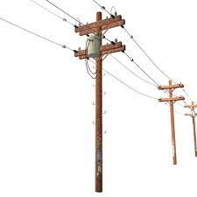
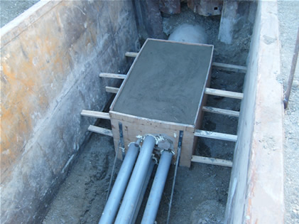
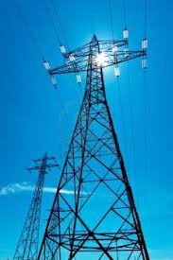
Yup Yup Nope

Slide 23
Poles and Infrastructure
Federal rules don’t apply in 21 states that have “reverse” preempted the FCC and regulate at the state level.
Federal rules don’t apply to municipal or cooperatively owned utilities -- 47 U.S.C. § 224(a)(1)
Federal rules don’t provide attachment rights to dark fiber services or private carriage of telecommunications
Federal rules don’t apply to utility fiber

Slide 24
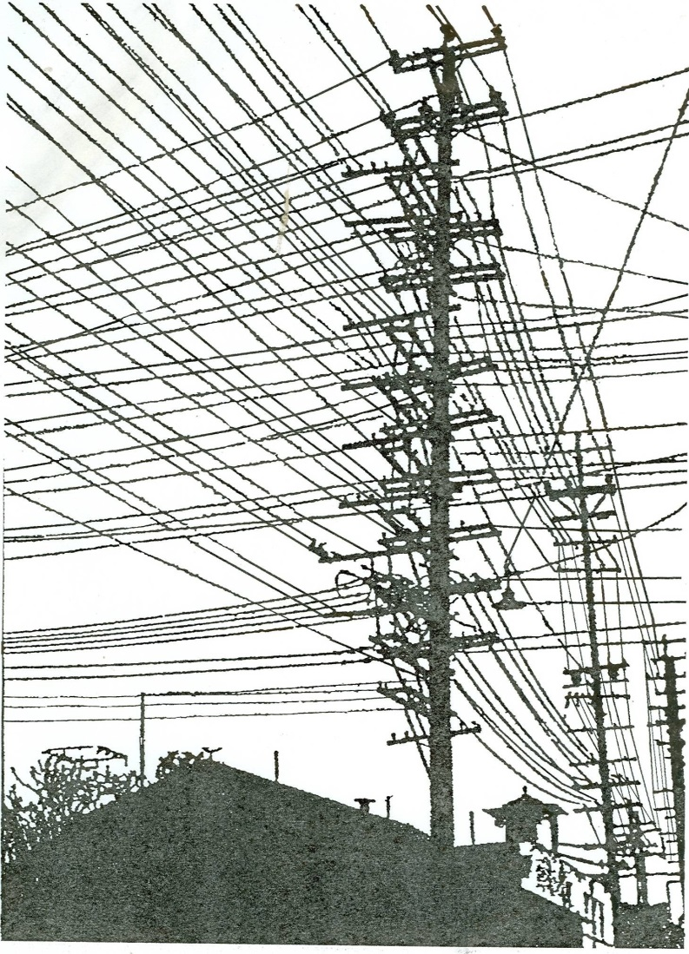

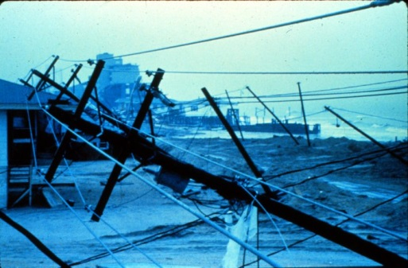
Why don’t the utilities just get out of the way?

Slide 25
NEW DEVELOPMENTS
Bulk Deployments – New FTTH networks seeking access to large number of poles in short time frame
Requires flexible approach on both sides
Greater use/dependence on contractors
One-Touch – ability to use single contractor to move/perform make-ready work on existing attachments at same time
Contract or Ordinance?
Prior notice?
Need to recognize legacy contracts and rights
Liabilities

Slide 26
Public Power Utilities
View safety, security and reliability of their electric system as top priority
View poles and conduit as a community asset
Want to encourage broadband deployment
Want (and have an obligation) on behalf of their consumer owners to obtain cost recovery
Provide access to all types of service providers – voice, video and data on similar terms and conditions

Slide 27
Working With Public Power Utilities
Bring the utility in to the planning process early
Don’t assume that utility and municipality have identical interests
Don’t confuse access to ROW with access to assets
Allow for in-kind consideration and where possible monetize the value of such services
Don’t get tripped up by non-discrimination or level playing field clauses

Slide 28
IV. Federal Universal Service Program
~12-18% (!) of gross revenues from the provision of “interstate” “telecommunications,” “telecommunications service,” and interconnected VoIP to “end users.”
Private carriage vs. common carriage
Exemptions may be available, some depend on what your customers are doing
Counterintuitive and sometimes illogical
FCC enforcement
See BSL Memorandum on the Federal Universal Service Program, available at http://www.baller.com/library/

Slide 29
USP: The Basics
Based on annual Form 499A and quarterly 499Q, the Universal Service Administrative Company (USAC) bills filers for the amounts they owe, including for LNP/NANPA/TRS if provider of “telecommunications service” or “interconnected VoIP”
499A is a commencement-of-service requirement for “telecommunications service” (but not BIAS, yet)
Providers that project contribution obligations exceeding de minimis levels for the year in question must file quarterly forms 499-Q by February 1, May 1, August 1, and November 1
Providers can pass through all or a portion of their USP payments to customers (if contract permits)

Slide 30
USP: Key Concepts
“Telecommunications” & “Telecommunications Service”:
  Dark fiber, by definition, does not include the transmission of information, which is an essential part of the definition of “telecommunications”
  Internet transport = “telecommunications”
    But assessable only if offered on a “common carrier” basis. Internet transport provided on a private carriage basis is not subject to assessment.
  Key implications for providers of “telecommunications service”:
    Must file 499-A when begin service, even if de minimis revenues. Potential retroactive penalties, etc.
    Providers of “telecommunications service” not eligible for some important exemptions

Slide 31
USP: Key Concepts
“Interconnected VoIP”:
  Not regulated under Title II, but treated much like “telecommunications service”
  Providers must file Form 499-A, even if would otherwise be exempt as de minimis, etc
  64.9% “interstate” (or traffic study)

Slide 32
USP: Key Concepts
“End User”:
  USP contributions assessed on revenues from “end users”
  For USP purposes, “end user” is not necessarily the last purchaser in a chain of distribution
  “End user” includes a purchaser of covered service (i.e., telecom, telecom service, VoIP) that does not itself make a USP contribution, because they are exempt or have failed to comply.
  An ISP is an “end user”
  A contributing reseller is not an “end user” (more later)

Slide 33
USP: Key Concepts
“Interstate” vs. “Intrastate”
  Nature of the traffic, not the location of the line
    “End to end” principle
    Internet traffic = “interstate”
    Interconnected VoIP: 64.9% “interstate”
    “10 Percent Rule”
  USAC’s “interstate” presumption: traffic is interstate in absence of certifications or traffic studies (on appeal)

Slide 34
USP: Key Concepts
Revenue from Resellers
  Wholesale providers’ revenue from services sold to resellers is exempt from USP, if wholesaler collects and maintains information (specified in FCC instructions) that support “affirmative knowledge” or “reasonable expectation” that the reseller or its customers make contributions to the USP.
  Reseller revenue must still be reported on Form 499-A (Block 3), if provider needs to file, but not used to calculate contribution.

Slide 35
E-Rate
  One of four federal communications subsidy programs funded by USP, administered by Universal Service Administrative Company (USAC)
  Federal subsidy for the provision of “eligible services” (telecom., Internet access and other services) to school and libraries
  Subsidy amount of 20% - 90%, depending on % of students eligible for National School Lunch Program
  Dark fiber, lit fiber, etc.
  Funds for construction may be available.
  See BSL annual E-Rate Memorandum, at www.baller.com/library

Slide 36
V. Cable Service and Franchising
Cable Act: Local governments may require cable operators (providers of “cable service” over a “cable system”) to obtain a local franchise and pay franchise fees in exchange for use of PROW.
Looming Issue: OTT service / “Online Video Distributor”
  Breakdown of traditional cable TV service model vs. local authority to require franchise and payment of franchise fees
  Incumbents concerned with competitive equity probably have a LPF provision in existing franchise.
  In an open access network, who is using the right of way, for cable franchising purposes? The retail service provider or the facility owner?

Slide 37
V. Cable Service and Franchising
FCC action:
  MVPD NPRM (December 2014):
    FCC proposed to clarify definition of “multichannel video programming distributor” to encompass online video distributors offering linear services
    Would enable OVDs to acquire programming on nondiscriminatory basis
    MVPD not the same thing as “cable service.”
    Strong opposition from NCTA.
  Set-top box NPRM: (Feb. 18, 2016):
    Would permit use of competitive MVPD navigation devices.
    Find a movie or show across multiple providers – some of which may pay a cable franchise fee, while others do not.
Grab your popcorn.

